Slide 1
Defoliator Management in BC
SERG Meeting February 7, 2023
Victoria, BC
Marnie Duthie-Holt, Kootenay Boundary Regional Entomologist
Lorraine Maclauchlan, Thompson Okanagan, Regional Entomologist
Debra Wytrykush, Cariboo, Regional Entomologist

Slide 2
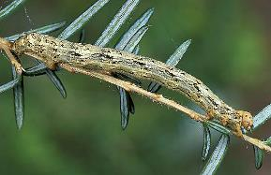
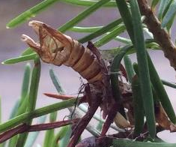
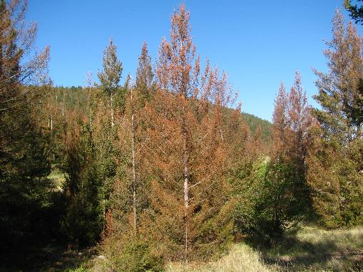
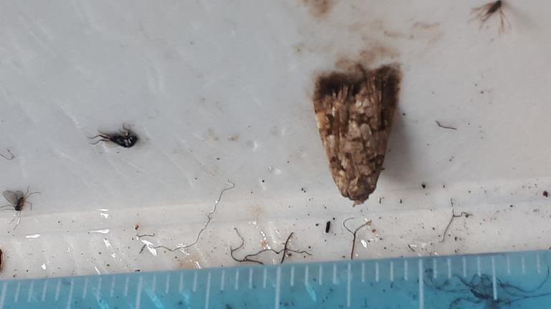
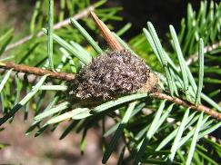
BCs Major Conifer Defoliators (all native)
Tree killers
Eruptive, kills trees in 1 year
Post-outbreak mortality and crown dieback (5 years after outbreak)
Early intervention in outbreak cycle to prevent damage
Protection of critical habitat
______________________________________
Western hemlock looper (IDL)
Douglas-fir tussock moth (IDT)
health risks (tussockosis –hairs on adults/ larvae, allergic Rx humans (1 in 5), horses, other animals, itchy, rashes, watery eyes and sneezing)
Tree damage/killers
Increment and height growth reduction
Reduce seed source, damage or kill understory, stem defects, top-kill and tree mortality, slow recovery post defoliation
Increased susceptibility to other forest health factors
Limits forest management options
___________________________________
Western spruce budworm (IDW)
2-year cycle budworm (IDB)
Notes:
IDL
extensive mortality of mature/ old growth hemlock (60-90% stems >50% defoliation will die
Larvae feed on new or old foliage, starts at top of tree, main hosts Hw, followed by Cw, Fd, Ba, Sx, broadleaf and shrubs effected at high populations
IDT
Morality critical Fd stands
3-4 year outbreak duration
IDW
Greater impact in northern expanded range than stands to the south
Feeding on older foliage 2nd spring which is when trees are most heavily damaged
IDB
Feeds on needles, buds and new cones
Feeding on older foliage 2nd spring which is when trees are most heavily damaged

Slide 3
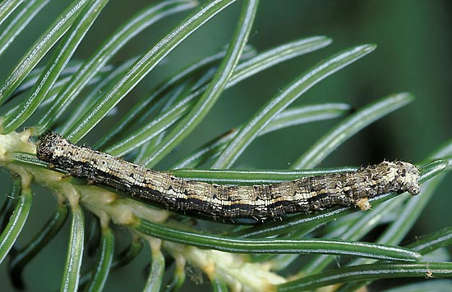
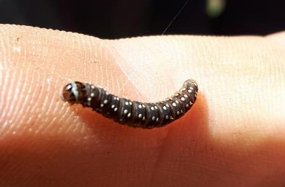
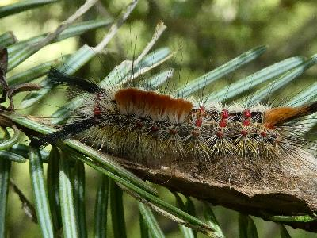
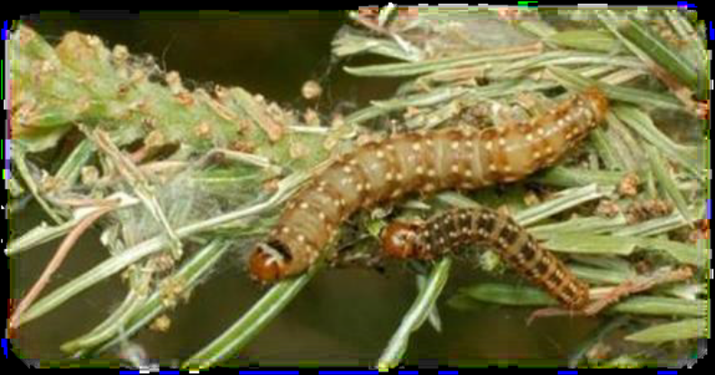
Conifer Defoliators Current Status
Western spruce budworm
  - population in low part of cycle and is slowly increasing as next outbreak cycle begins (CAR, TOR)
Western hemlock looper
  2019-2021 last outbreak, Coastal & Interior
Douglas-fir tussock moth
  - populations low; in-between outbreak episodes
2 year cycle budworm
- odd years/ off years

Slide 4
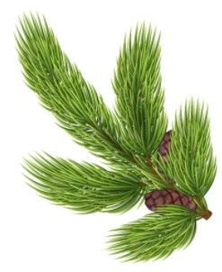
History of defoliation management in BC
1909: Western spruce budworm (IDW) first recorded in BC on Vancouver Island, with outbreak cycles lasting upwards of 25 years
Since 1916: Southern BC – 8 outbreaks IDW representing 1.6 million ha defoliated with outbreak frequency, severity and duration increasing over last century as a result of fire exclusion, forestry practices influencing stand structure and density, and changing climates.
1986: Southern interior had largest outbreak of IDW on record
  there was no management strategy for defoliators and no experience within the B.C. government of spraying the biological insecticide, Bacillus thuringiensis var. kurstaki (B.t.k.).
1987: defoliator program initiated to determine which stands (stand structure, density, age) were most impacted by IDW and where Btk treatment would be most effective.
  Collaboration with Canadian Forest Service entomologists, (Drs. Roy Shepherd, Imre Otvos, Rene Alfaro) and Branch specialists, the Kamloops Forest Region (now Thompson Okanagan Region) embarked on a series of spray trials, impact assessments and biological studies.
  Developed a biologically, ecologically, and cost-effective strategy for managing western spruce budworm and other defoliator species.
Now: Defoliator management is one of the keystone programs in the Forest Health program in the southern interior.

Slide 5
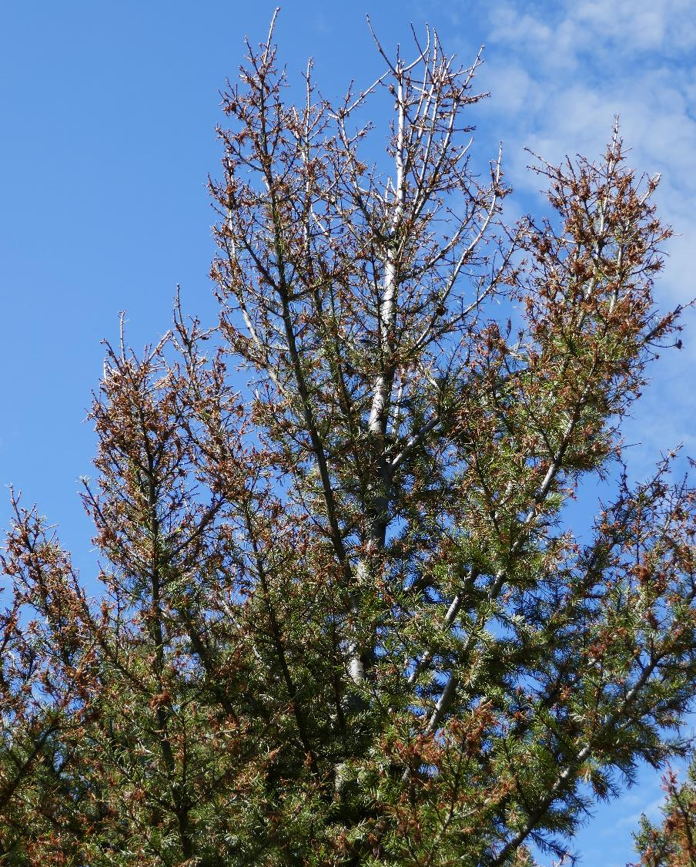
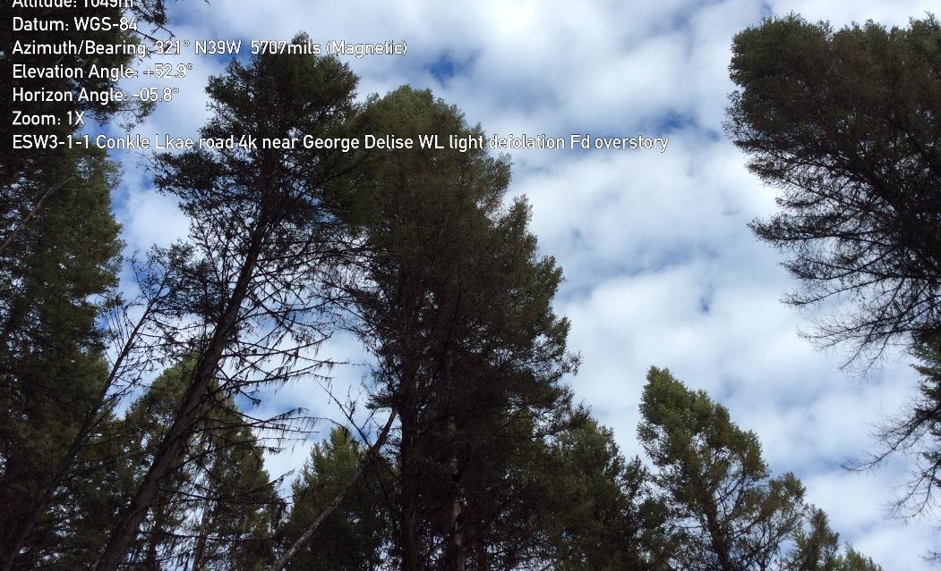
Defoliator Management
Long term – stand management
Promote age and species mosaics across the landscape
Density (well spaced) and stand structure manipulation (single canopy)
Susceptibility rate at risk landscapes

Slide 6
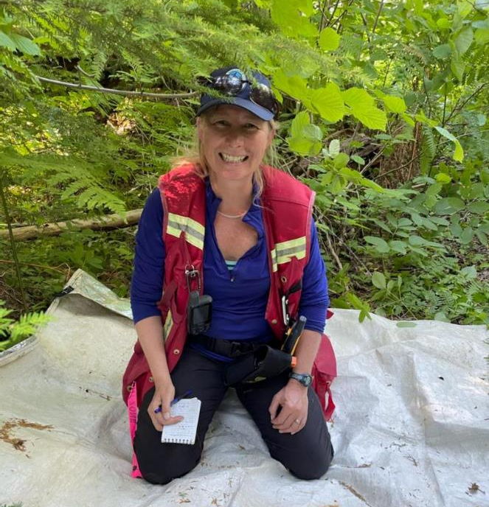
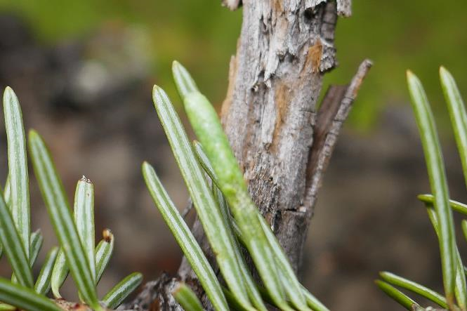
Population Monitoring
Aerial Surveys: AOS & detailed (helicopter recces)
Adult Pheromone trapping at PSPs – IDT and IDL (warning signal for impending outbreak) (started 1992)
3 Tree beatings – assessment of species richness and abundance
Egg mass surveys - late summer/ fall, predicted defoliation, IDW/ IDT, occasionally for IDL

Slide 7
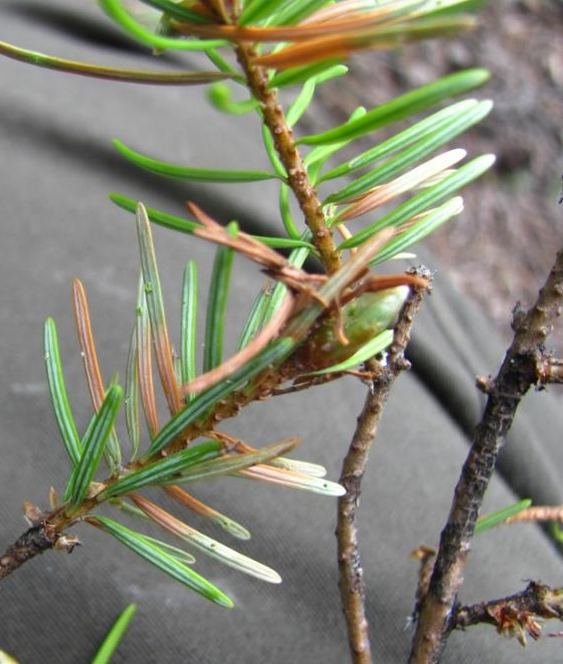
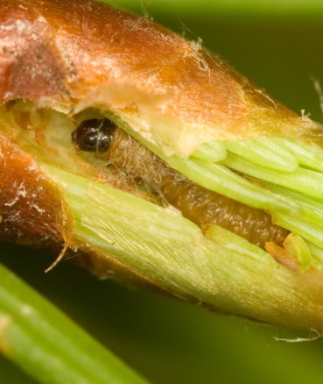
Predictive Sampling (IDW)
Egg sampling
Budmining (and needle mining) – qualitative assessment – used for timing of sprays & verify defoliation predictions made previous fall from egg surveys
Larval surveys – determine insect density, defoliation severity or spray efficacy
  2nd instar larval sampling – predicts next season’s defoliation levels based on overwintering larvae L2
  Late instar larval sampling – describe population trends, stand damage or evaluate efficacy of insecticide treatments.

Slide 8
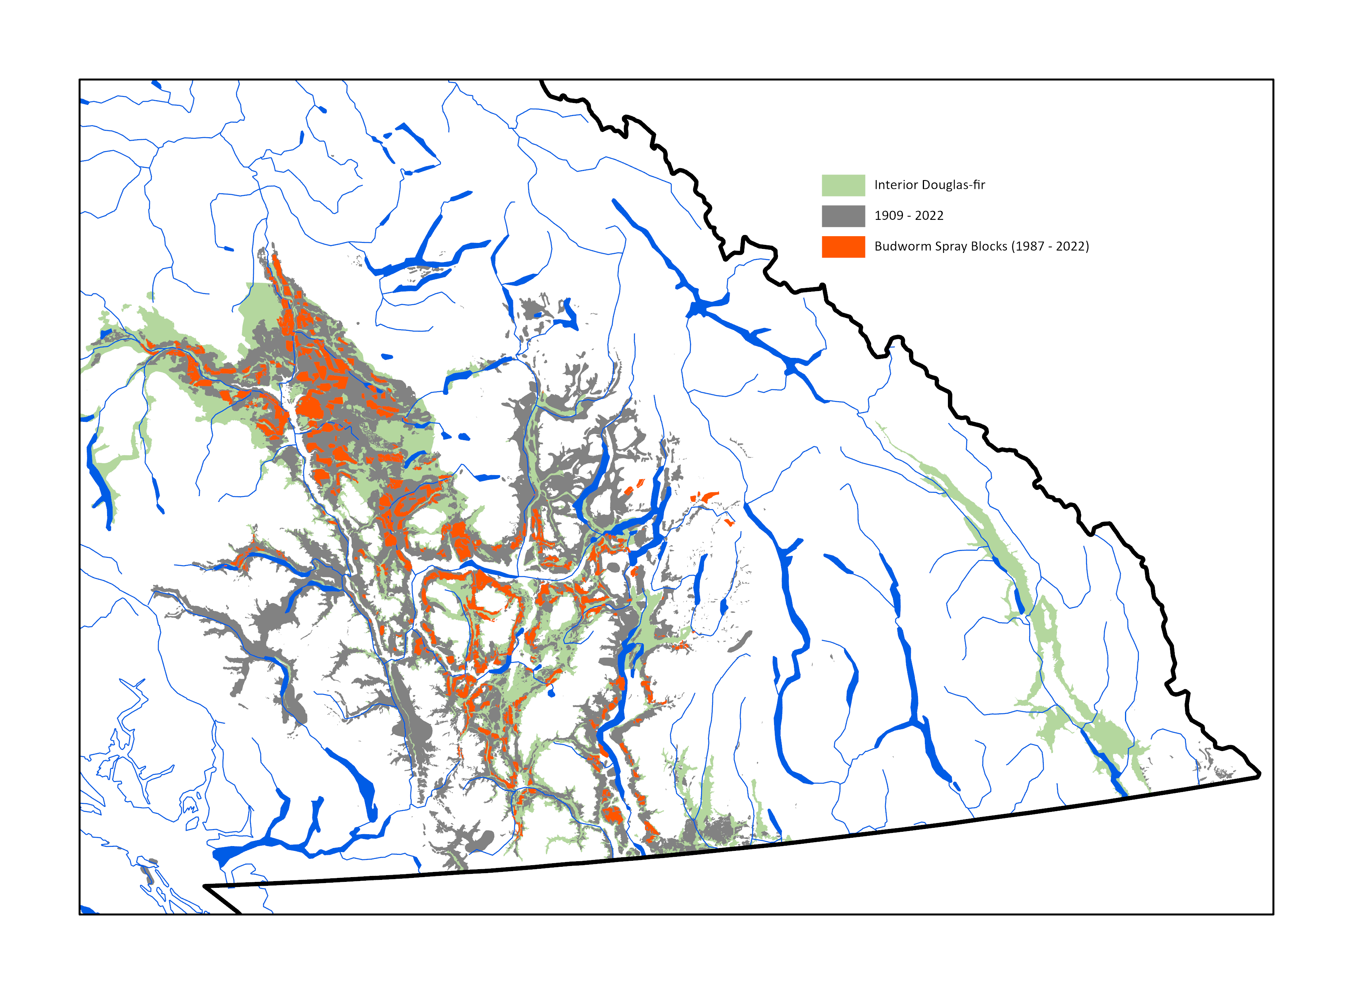
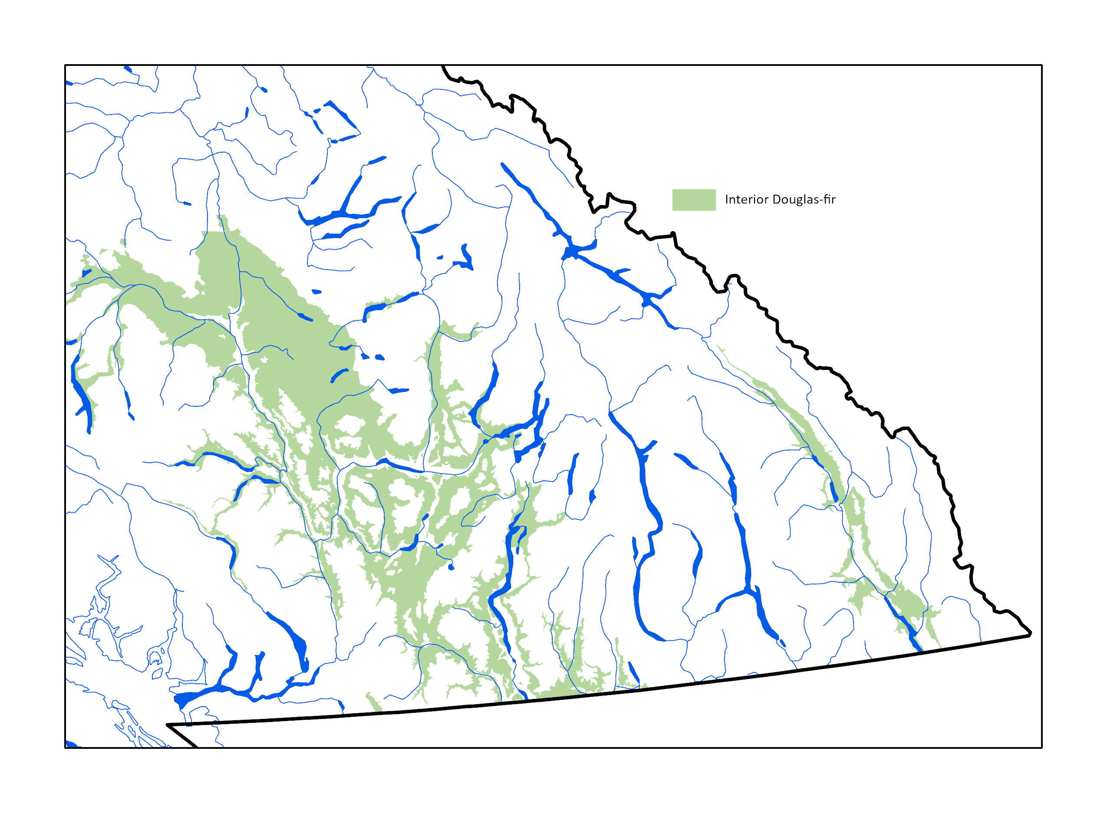
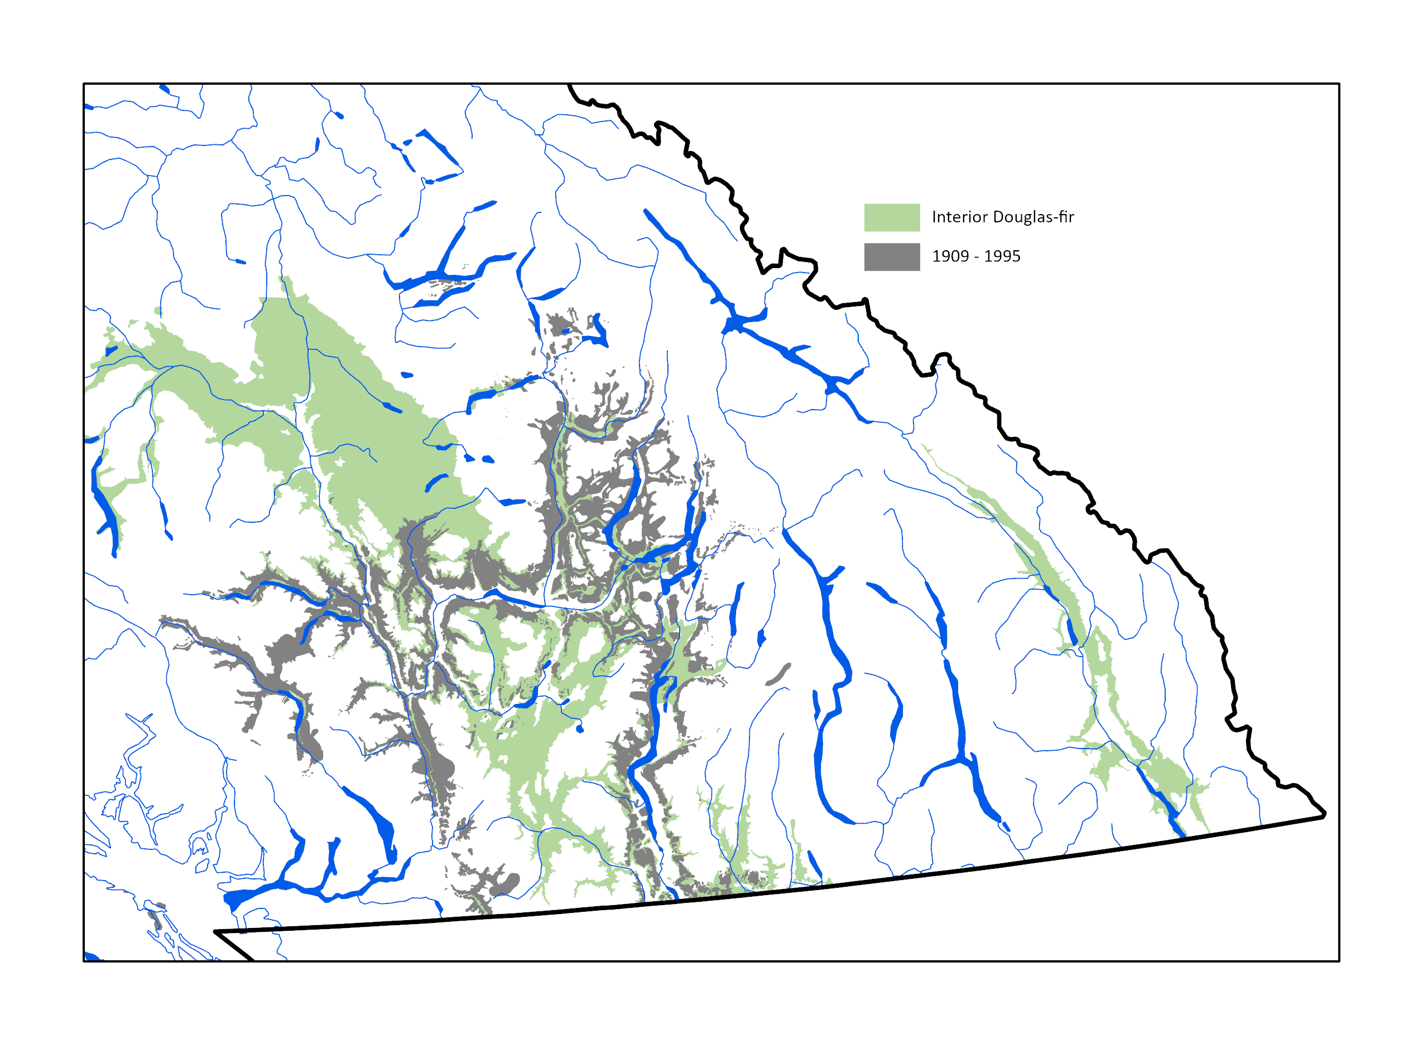
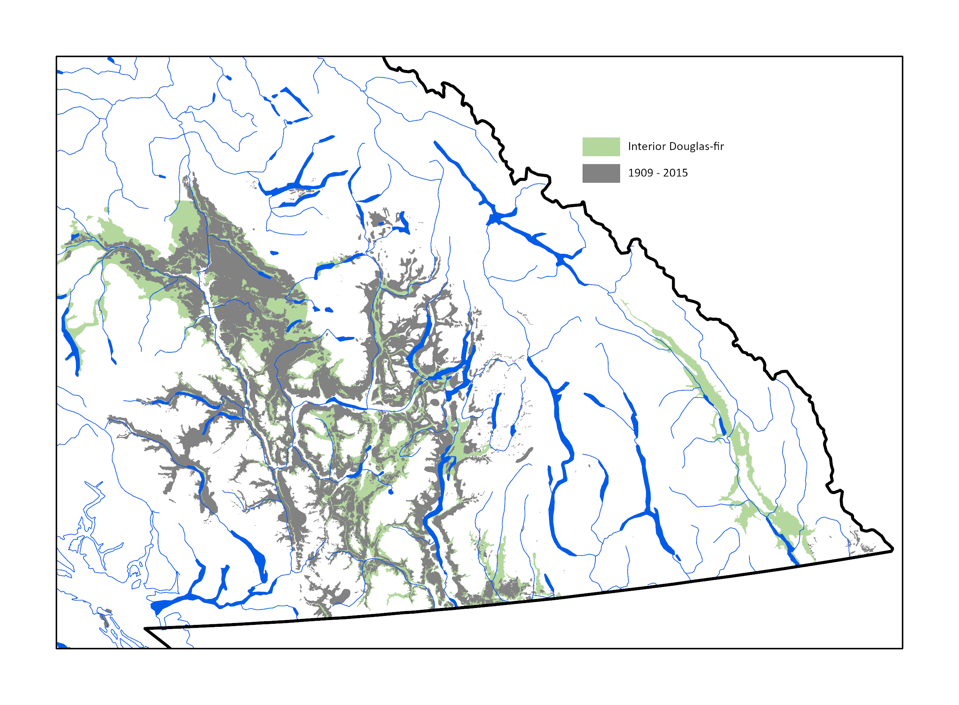

History of budworm defoliation and treatment in B.C.

Slide 9
Western spruce budworm (ha defoliated in BC, 1986-2021)

Slide 10
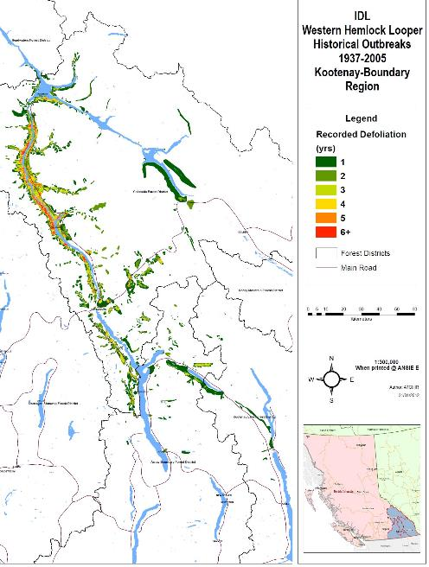
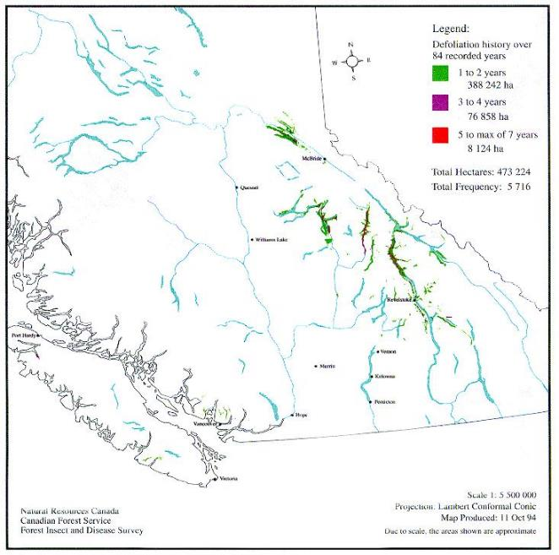
Historical incidence of IDL KRB 1937-2005

Slide 11
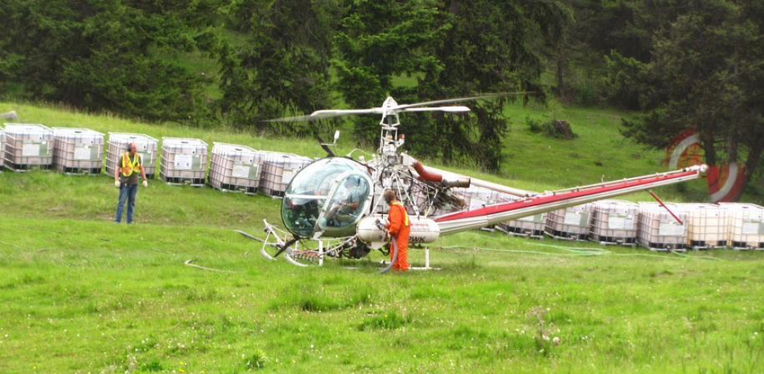
WHEN: Short term – direct control
When damage thresholds are reached / surpassed
Typically one year after observed defoliation
Post stand treatment (i.e. thinning) when populations predicted >light defoliation
Other values at risk
>5,000 ha spray required (efficacies of scale)

Slide 12
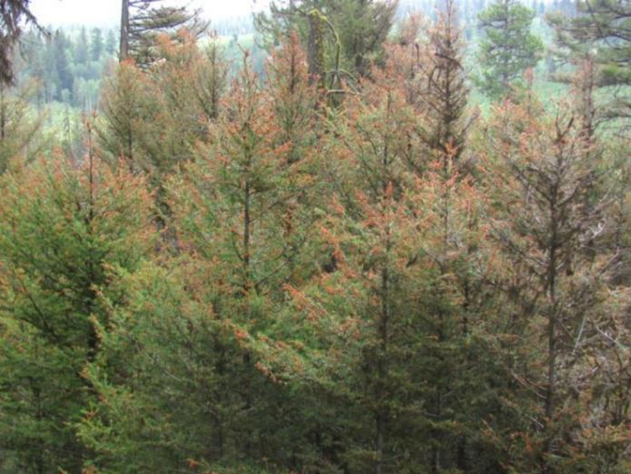
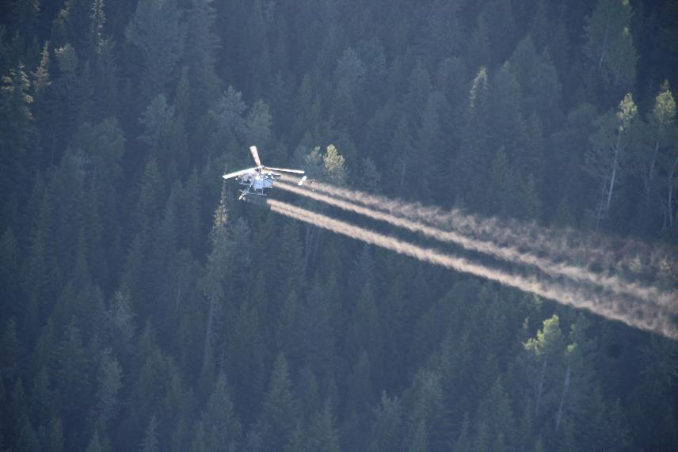
WHEN: Defoliator Management
Short term – direct control
Stands predominated by intermediate size stems and less structural diversity at highest risk of severe top-kill damage
Intervention with B.t.k. is recommended when budworm defoliation predictions >light

Slide 13
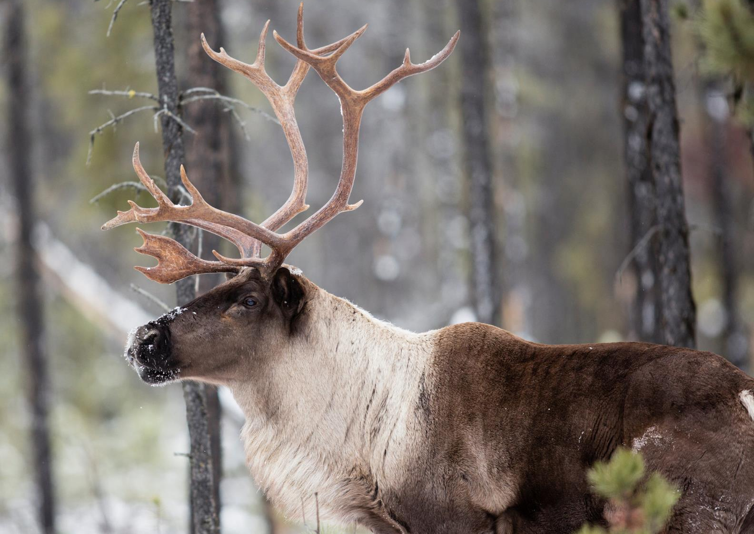
WHERE: Short term – direct control
Mid-term stands
Scheduled for harvest in 5-10 years (will add increment)
Managed, multi-structured stands
Wildlife, First Nations management values, or other values to protect
IDW defoliation at or predicted to exceed, acceptable damage
Special areas (seed production, etc.)

Slide 14
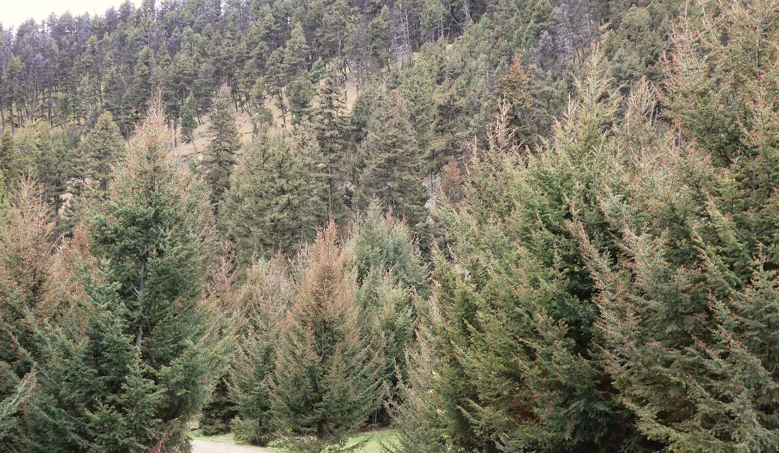
WHERE: Short term – direct control
High priority stands in THLB (timber harvesting land base)
Intermediate age or multi-age
Good access
Moderate to high defoliation predicted

Slide 15
HOW: Short term (direct control)
Integrated Pest Management Act/ Regulations
Pest Management Plan (updates, statutory advertisements, 1st Nation consultation, community consultation)
Pesticide Use Notice (PUN)
Conformation holder – annual notice of intent to treat
BC Pesticide Service License and BC Pesticide Application Certificate
Personnel: Aerial applicator contractor/ ground support (Wx stations/ population sampling) – experience in aerial pesticide application (forestry)
Logistics: Confirm spray blocks, staging sites, access, safe Btk storage

Slide 16
BC Spray Programs by Region (1987-2022)

Slide 17
BC Spray Programs (1987-2022)
40,000 ha planned CAR 2023

Slide 18
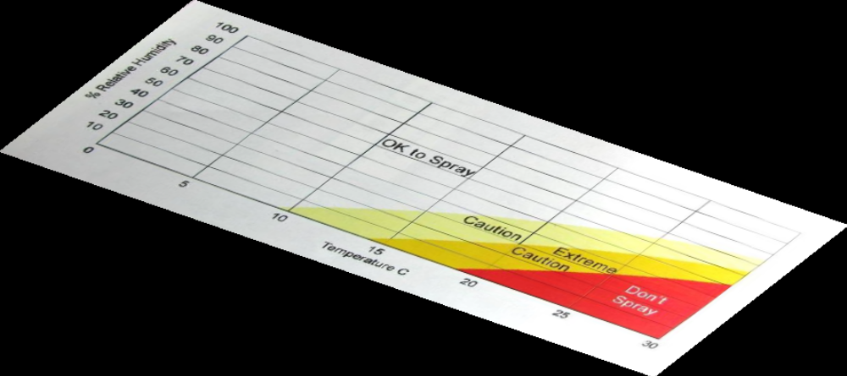
Spray challenges
Weather (optimal treatment window)
  Wind
  RH
  Temperature
  Precipitation
  Abnormal atmospheric conditions
Resources
  Support personnel
  Btk
Notes:
Temperature
2021 heat dome – temperatures where >20 degree by 0700
Support personnel
- Difficulty obtaining/ keeping short duration, crazy hours, not attractive work

Slide 19
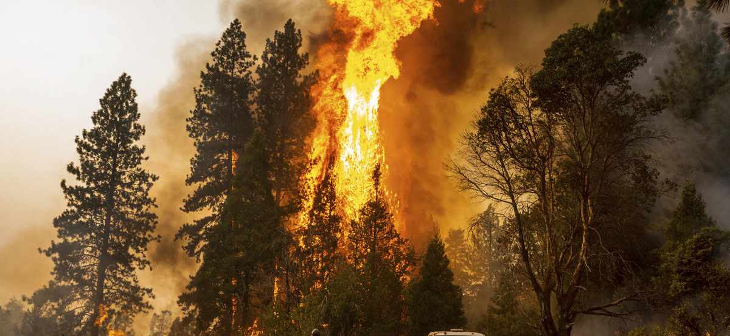
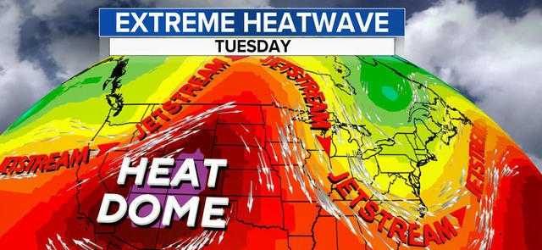
Spray challenges
Communication
  Government vs. public radio channels
Safety
  Work outside of flight monitoring timelines
Fire
  Spray blocks burning or burnt right after spray
  difficulty moving equipment around due to restricted areas
  evacuations
Population dynamics
  Cool springs: delaying development, pushing back operational timelines
  Heat dome 2021: crashing IDL populations in IDF (still strong in ICH); population sampling difficult at 40 degree temperatures!

Slide 20
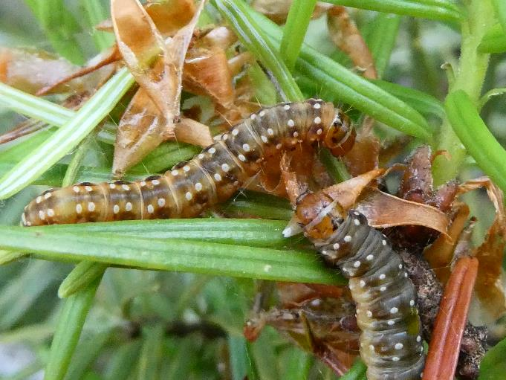
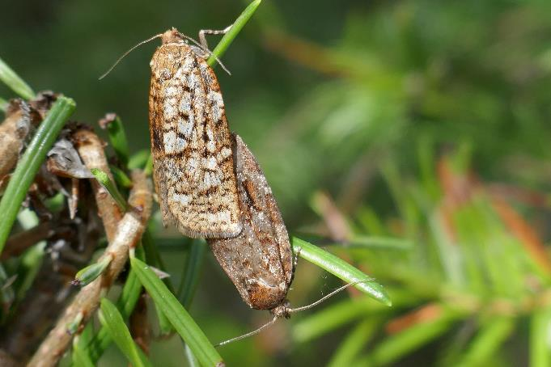
Future considerations
Defoliation events are becoming more prevalent, sustained and damaging
Long-term stand management must be initiated on a larger scale
Spraying is an effective and economic tactic in the short term
Spraying should be considered sooner in outbreak cycle (i.e. Year 1) dependent on damage from past defoliation events
Spraying should be conducted in areas thinned when defoliation is predicted in the coming season
Designate priority treatment areas within historic defoliator ranges (IDW)

Slide 21
Extra information

Slide 22
IDW Stand susceptibility and risk rating
Species composition – leading Fd
Stand structure – multi-structured or predominantly layers 2 and 3 most damage
Stand density (by layer) – mod to high density (critical for layers 3,4)
Tree and stand vigor
Host tree age
Biogeoclimatic zone – IDFdk and IDFxh highest risk
Elevation and aspect
IDW – outbreak history
  Location – outbreak region, elevation
  Extent and severity – insect density
  Periodicity and duration
  Consecutive years of defoliation (duration of outbreak cycle)
  Cumulative years of defoliation (# past outbreaks)
  Range (changes in extent, elevation, climatic influence)
Climate – changing spring weather and drought periods

Slide 23
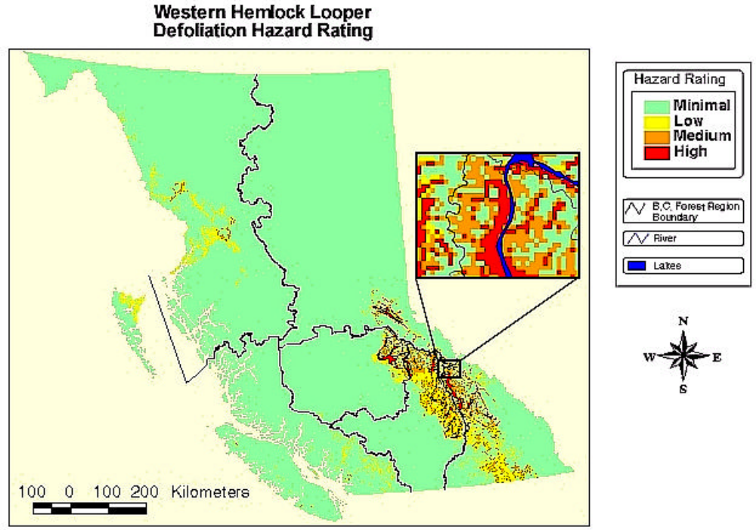
Course Hazard Rating (IDL)
Defoliator Mngt Guidebook 1995; Borecky and Otvos 1999
Proximity to past outbreak
Location of mature hemlock
Biogeoclimatic zones
ICH, SBS, ESSF
Species composition
Stand density
Stand structure
dense, overstocked
Age class
DEM Elevation range:
500-1,500m
Ecodistrict
avg. June rainfall: 36 – 46 cm

Slide 24
